Slide 1







Pay Transparency & Pay Equity
Driving Pay Fairness
Over the last 5 years we have seen laws all over the world that intend to increase pay fairness in multiple ways:
Limit ability of employers to ask what candidates made in previous job
Enable employees to more freely share their own pay rates with others
Disclosure of pay ranges in job postings – even to existing employees upon request
Encouraging employers to conduct proactive pay equity analyses
Why is it important to be proactive with Pay Transparency and Pay Equity?
Compliance & Risk Mitigation
Respond to Social Movements & Activism
Investor Relations
& Board Focus
Talent Competitiveness & Engagement
Building an open work environment to drive trust
Because it is the absolute right thing to do

Slide 2
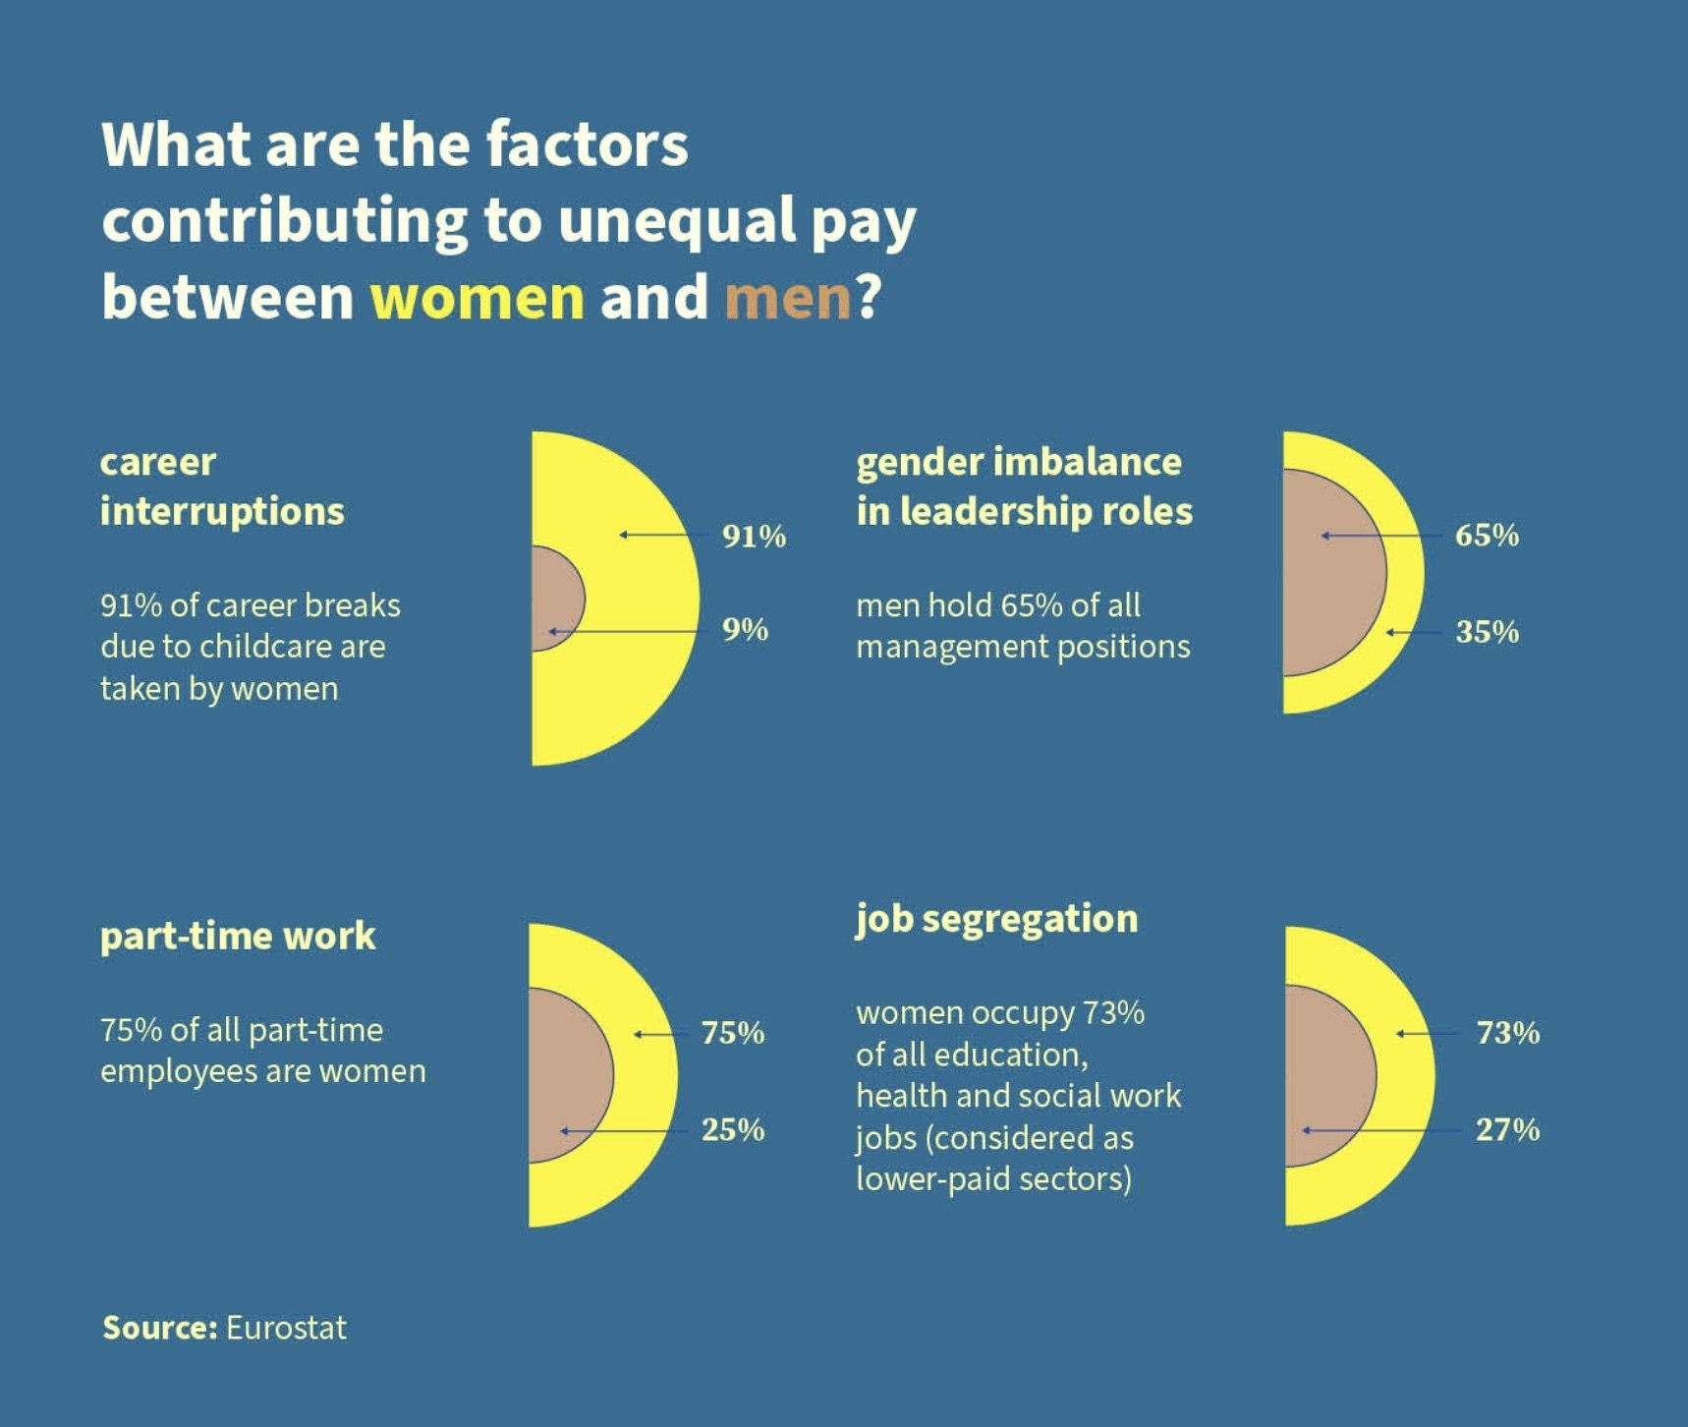

Slide 3
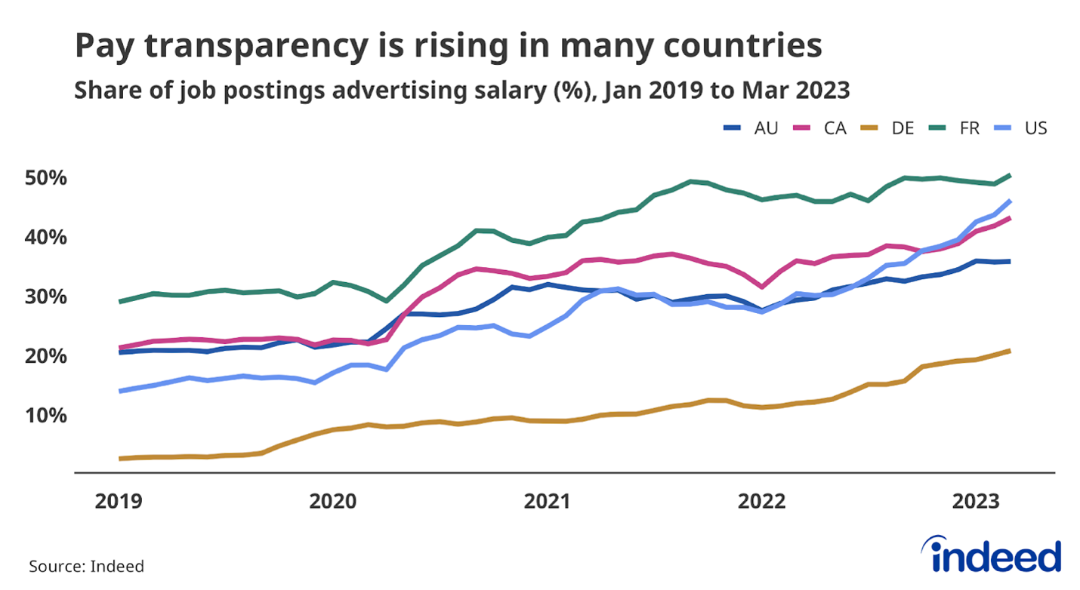

Slide 4
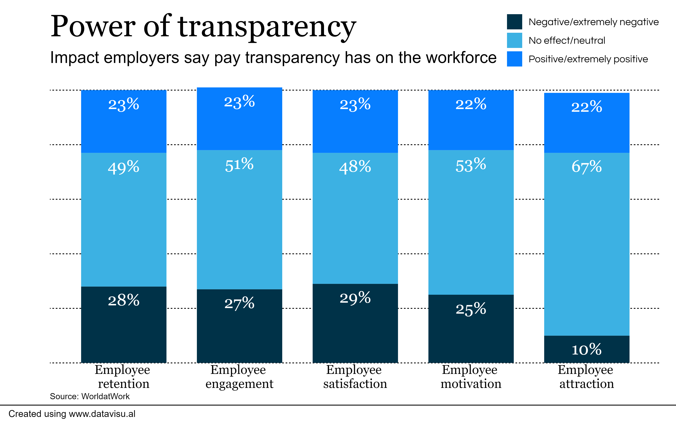

Slide 5

Pay Transparency – A Global Movement
Pay equity is a driving force behind the new laws
US
Several US states now have pay transparency laws in place with others to follow. Laws continue to come online with additional penetration pending (i.e., promotional criteria in NJ)
Middle East and APAC
Pay transparency is growing in importance and in reinforcing diversity and inclusion.
Israel
New reporting obligations, Male & Female Workers (Equal Pay) Law as of June ’22.
Canada
Ontario, Pay Transparency Act 2018. BC, new Pay Transparency Act, passed May 2023, places new requirements on employers.
Singapore
Listed firms to disclose CEO/directors salaries as of Dec ’24.
UK
GPG reporting legislation in place since 2017 for companies with more than 250 employees.
The Government is currently reviewing the GPG requirements.
The UK Government also introduced a pilot scheme 2022 on Pay Transparency.
Japan
As of July 8, 2023, organizations need to disclose progress for expanding professional opportunities for women and steps to improve worklife balance
EU Member States
The EU Pay Transparency Directive has been formally approved by the European Parliament and came into force on June 6, 2023.
EU member states will have up to 3 years to transpose its provisions into their national laws and we anticipate that this will be much sooner in some EU countries.
Proprietary and Confidential
5
Proprietary & Confidential

Slide 6


EU Pay Transparency Directive
Key Points to Note
Job applicants will have the right to receive information on the initial pay level/range for any advertised position and employers will not be able to ask about previous or current pay of any job applicant.
Employees will have the right to request, and receive in writing, information on their individual pay level and the average pay levels for categories of workers performing the same work as them or work of equal value to theirs.
Employers will need to ensure that they have a clear understanding of work of equal value in their business, not just equal pay for equal work, and demonstrate that they include gender-neutral formal analytical job evaluation criteria.
Employers with at least 100 employees will have to publish information on the pay gap between female and male workers. If a Gender Pay Gap exists of more than 5.0% then employers must work with their employees’ representatives to conduct a joint pay assessment (i.e., pay equity analysis) and develop a gender action plan​.
Any pay differences must be linked to gender neutral objective criteria (e.g., performance, responsibilities, skills).
Employers must share information on how pay is set, progressed, and managed.
Member states will have to put in place effective, proportionate and dissuasive penalties, including fines, for employers that infringe the rules. Compensation (uncapped) would be available to victims of pay discrimination, with the burden of proof on the employer.
Proprietary & Confidential
6

Slide 7
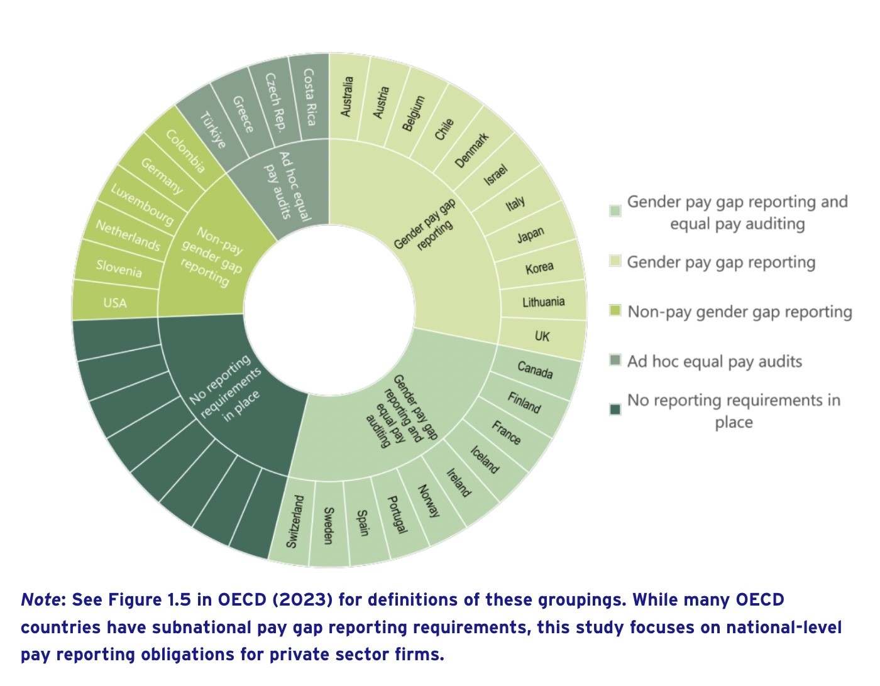

Slide 8
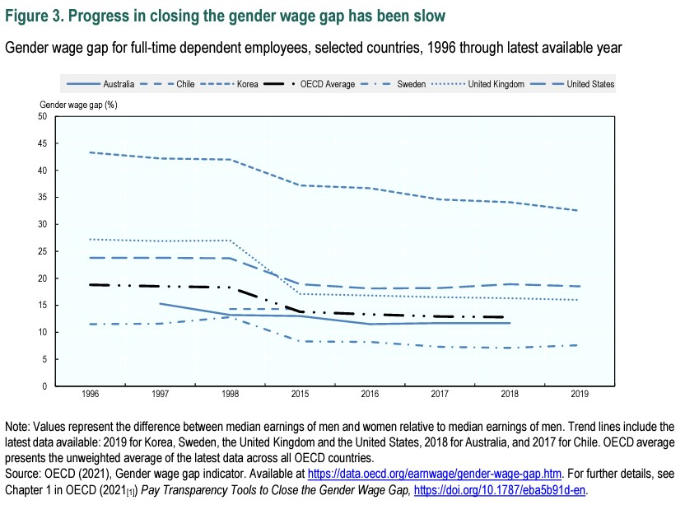

Slide 10
